Slide 1
Sachs Foundation
Scholarship Know How’s and To Do’s

Slide 2
Meet Our Staff

Slide 3
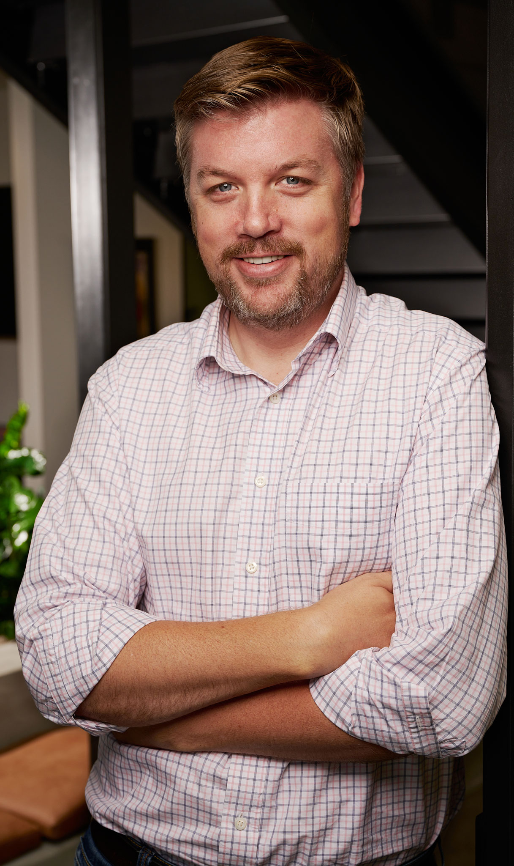
Ben Ralston
President

Slide 4
Pamela Roberts, MSW
Chief Operations Officer

Slide 5
Tarin Kemp
Director of External Relations

Slide 6
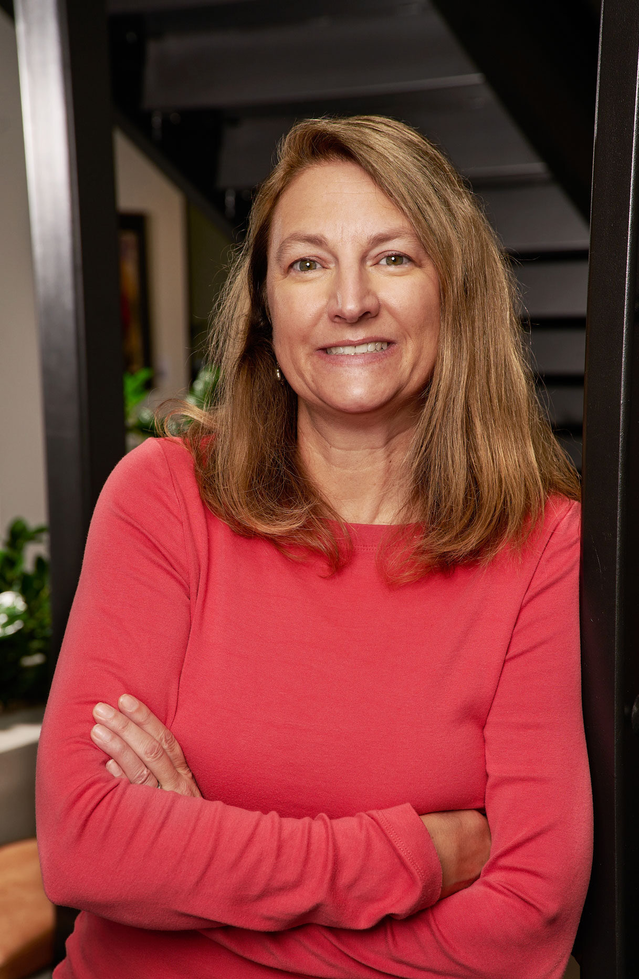
Brook Sklenar
Program Administrator

Slide 7
Best Advice on your relationship with the Sachs Foundation
Communicate,
Keep in touch,
Feel free to reach out
(there are no bad questions)

Slide 8
WE Can Assist With
Confirmation on scholarship policies (GPA, credits, Incompletes, Failures, Withdrawals)
Funding Needs (studying abroad, school trips/programs)

Slide 9
We can only assist with what we know
Take the time to answer our transcript questions, thoroughly
Upload photos, when requested
As a Sachs Foundation scholar, you are our volunteer supplier of information

Slide 10
Wrap Around Services: *tele-Health *financial *Legal

Slide 11
Transcript Submissions
Semesters | Quarters
Fall (December/January) | Fall (December)
Spring (May/June) | Winter (March)
Summer (August/September) *if it applies | Spring (May/June)
*Always submit your transcripts through Community Force

Slide 12
Special Circumstances
Death in Immediate Family
Personal health issue with Dr.’s note, will be taken under consideration
Advisor’s note, will be taken under consideration
Studying abroad

Slide 13
Scholarship Checks
*Scholarship check processing is delayed after Winter Break
*Be sure to keep us updated on your school’s office for scholarship funding
*You hold the responsibility of when we can send your check
When
After Transcript is Submitted
Prior to start of new quarter/semester
Why
You met credits & GPA requirements
Scholarship check mailed to university or college
Sent individually through BillPay via USPS
How

Slide 14
Keep Us Updated/ Current/ Informed
On your successes, failures (we like photos)
New addresses, email addresses, phone numbers
Articles, awards, internships, jobs
Switching schools, majors, dropping courses
Need for an Extension
Studying abroad
Participating in Summer programs

Slide 15
Requirements for Being A Sachs Foundation Scholar
Maintain a GPA of at least 2.5
Have no Failures (F), Incompletes (I), Unsatisfactory (U), or equivalent grades
Be enrolled in at least 12 credit hours or whatever criteria your institution considers full-time enrollment
If you need to put your scholarship on hold or extend your attendance at school, we will need a letter explaining this

Slide 16
Community Force
To upload transcripts each semester/quarter
To apply for the graduate scholarship
Upload additional items that were requested

Slide 17
Details of your Sachs Foundation Scholarship
Scholarship grant award = $10,000 a year
(sent at beginning of semesters or quarters) – unless a named scholarship = $12,500 a year
Renewable up to 4 years
Eligible for the Sachs Foundation Graduate Scholarship

Slide 18
Financial Aid Offices
Speak with them on Award Displacement and/or being Overfunded
Be sure to keep us updated on where to send your scholarship checks
Talk to them about how they can help (other funding options – don’t just settle on student loans)

Slide 19
Email Us
Updates (email addresses, phone numbers)
Extension letters (graduating later, switching majors)
Special requests (deaths in family, sick at finals, etc.)
Financial need
Questions on requirements (before withdrawing from courses, switching schools)
Academic misconduct

